Slide 1

Python Devoloper in CodeAplha
Presented by:
Maheshwar rao Valuvajjala
Computer Science and Engineering
Enrollment Number: 21CS002430
Supervisor: Mr. Shivam Upadhyay

Slide 2
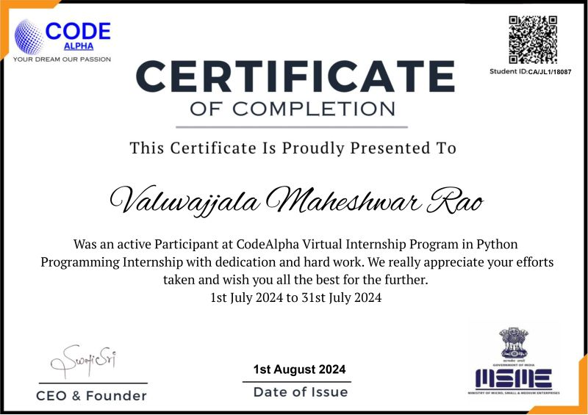
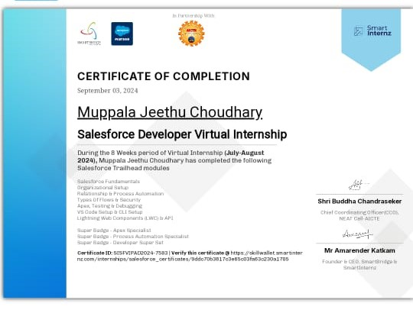
Internship Certificate

Slide 3
Introduction
Company Name : CodeAplha
Brief Description : "CodeAlpha specializes in Python development tools, enhancing programming efficiency and performance.“
Overview of the Internship Program : Modernized Apex command codebase using oclif for improved performance.".
Importance of the Internship: Provided practical experience, enhanced skills, and improved career prospects."

Slide 4
Internship Objectives
Duration: 1 Month (July 10th - August 31st )
Location: Remote
Internship Type: Part-time
Company's Expectations: Deliver high-quality work, solve complex problems, and meet deadlines.
Internship Objective :Modernize tools, enhance performance, and improve user experience efficiently.

Slide 5
Key Project & Responsibilities
Project Title: Enhancement ProjectModernizing Apex Command Codebase with Oclif Plugin Framework at CodeAlpha
Brief description : Modernized Apex commands with oclif plugin framework at CodeAlpha
Your role and contributions : Developed oclif framework, optimized performance, resolved code issues.
Technologies/Tools used : Python, oclif, Apex, Command Line Interface (CLI), debugging tools..
List of Skills: Python programming, plugin development, CLI tools, performance optimization, problem-solving

Slide 6
Project Description
Project Description: Modernized Apex commands with oclif, enhancing performance and functionality.
Focus on impact :Improved speed, reliability, and user experience for debug log tools.
Key Achievements/Outcomes: Optimized commands, resolved critical issues, and implemented innovative oclif framework..
Visuals:

Slide 7
Lessons Learned
Key Takeaways:
- Enhanced skills in Python, oclif.
- Experience in virtual teamwork.
Challenges Overcome: Resolved performance issues, improved command reliability, and addressed user feedback

Slide 8
Conclusion and Results
The project significantly improved Apex command performance and reliability, showcasing effective use of oclif and advancing personal development.

Slide 9
Future Work
Next Steps:
- Expand Plugin Framework: Develop additional features and plugins to further enhance functionality and versatility
User Feedback Integration: Continuously gather and incorporate user feedback to refine and improve tools.

Slide 10
Mentor Contact Information
Mentor Name: Mr. Shivam Upadhyay
Email : info@thesmartbridge.com

